Slide 1


Titolo presentazione sottotitolo
System and Methods for Big Unstructured Data
Project presentation 2022 - 2023
Milano, XX mese 20XX
DBLP - Bibliography Database case study

Slide 2

Group 5
Alireza Yahyanejad
Leonardo Giusti
Fateme Hajizadekiakalaye
Carlo Sgaravatti
Emmanuël Caputo

Slide 3

Description of the problem
Digital Bibliography & Library Project
Users affiliate to an organization
Organization and agency
Users with different roles
Users write comments
Publications and categories and keywords
Publication in conference, journal, and series
Journal, conferences, and series as a venue

Slide 4
Assumptions
Each Publication could contain a reference to an External resource ( for example Wikipedia web page )
Each person can comment on a publication, no matter his role (contributor/author).
Contributors cannot publish a publication, only agencies can.
Each Publication can be part of at most one Series, at most one Conference, and at most one Journal
Each Publication can be funded and/or published by a different / the same Agency

Slide 5
Assumptions
An Agency does not have to be an Organization (an Agency does not need to have affiliations) but an Organization is an Agency (also an Organization can publish / fund publications)
Each Agency can publish also Venues
A person has to be affiliated to an organization in order to contribute to a publication
Each viewer can access the text (pdf) of the publication by clicking on the supplemental material (URL of the pdf), but the abstract is still accessible without the need to access the pdf file

Slide 6
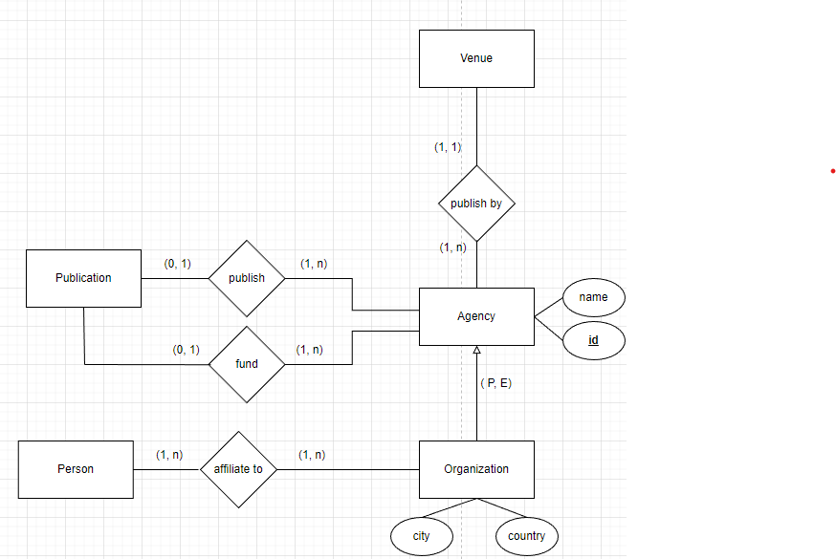
ER diagram aspects
Agency
Agency is a company that can fund and/or publish a publication. It also can publish a venue.
Organization is the element of the Partial Exclusive hierarchy w.r.t. Agency.
For instance, Politecnico di Milano is an organization and we all could be its affiliates.
Fig 1: Zoom on the Agency concept from our ER schema

Slide 7
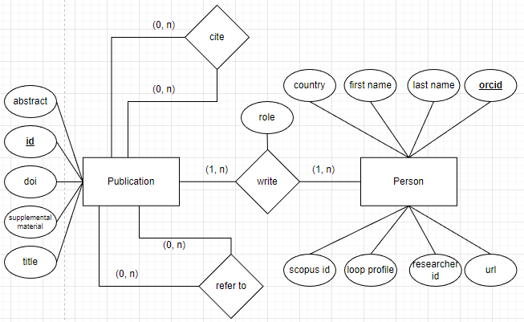
ER diagram aspects
Publication and Person
Person is identified by the Orcid but we also collect other external identifiers of other platforms as Scopus, Loop and research id.
A Publication is a document (article, Ph.D. thesis, book, ...) written by users and published in the DBLP database.
And also, a Publication can cite and reference other publications.
Fig 2: Zoom on the Publication and Person concepts from our ER schema

Slide 8
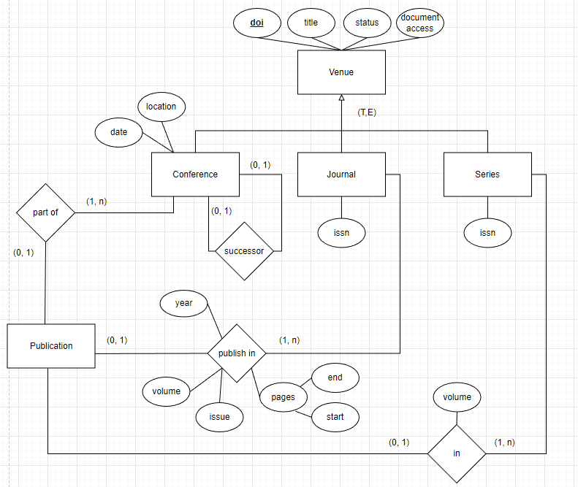
ER diagram aspects
Venue
Venue is a space where publications
are shown. Each venue is identified
by his DOI.
Conference, Journal and Serie are elements of a total exclusive hierarchy of Venue.
Fig 3: Zoom on the Venue concepts from our ER schema

Slide 9
Neo4j
Document structure
DBLP-Citation-Network V13
More complete
Preprocessing
Select small part of publications.
Remove authors without name and id
Assign id to entities with null id
Split name of authors
Make some attributes case insensitive
Change type of some attributes

Slide 10
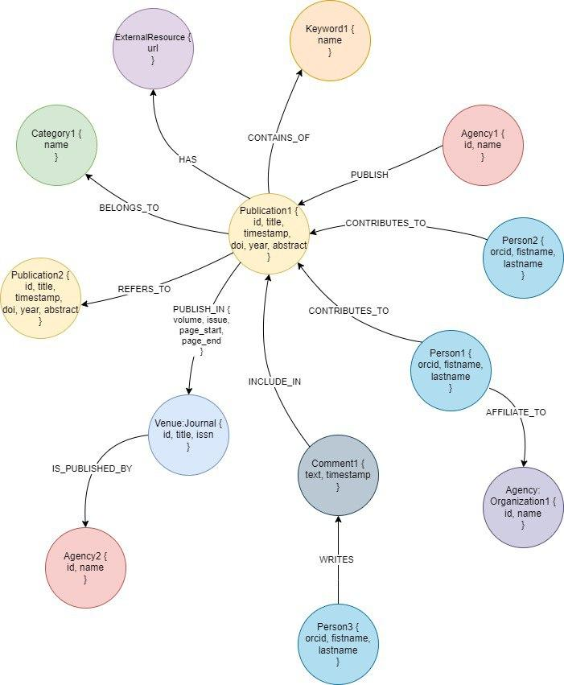
Neo4j

Slide 11
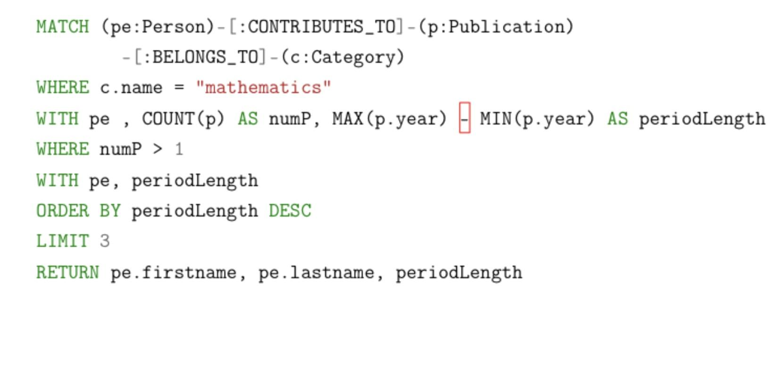
Neo4j
A query example
Find the authors that have been active for the longest period of time in the specific category named “mathematics”.
Selecting all authors that have published some publications which belong to the category "mathematics"

Slide 12
Neo4j
A query example
Grouping the results by authors, and counts the number of publications and calculates the active period length for that author.
Only the authors that have published at least 2 publications are kept.

Slide 13
Neo4j
A query example
The result of the previous aggregation is ordered by the length of the active period.
Finally, only the top three authors are returned.

Slide 14
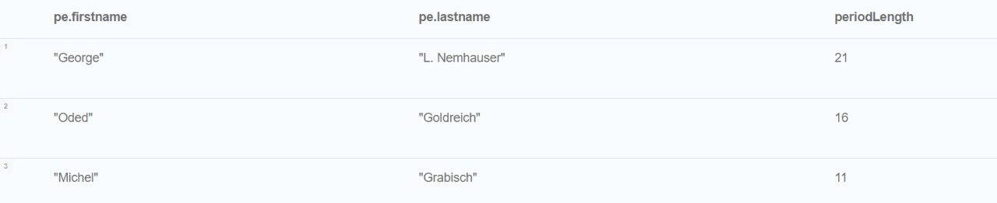
Neo4j
The result

Slide 15
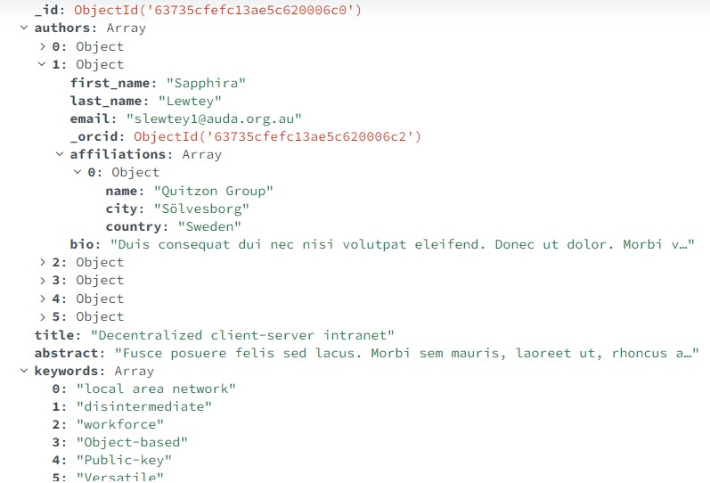
MongoDB
Document Structure
All the data is in a single collection “publications”.
The data was randomly generated using the Mockaroo random generator.
All the information about the authors is contained in an Array of Objects field. Affiliations of the authors are contained in a nested Array of Objects.

Slide 16
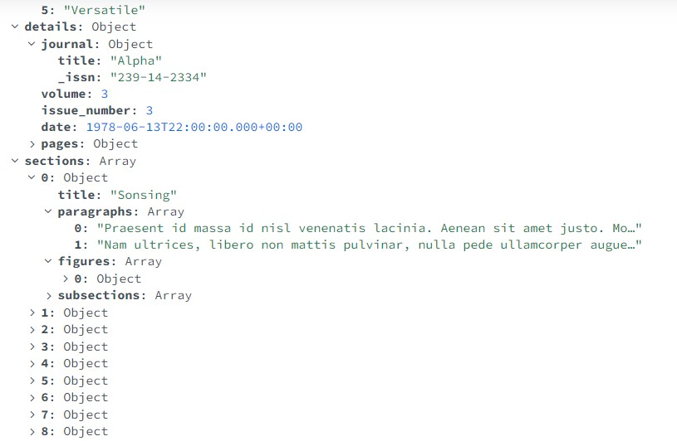
MongoDB
Inside the details subdocument there is the journal on which the publication is published
A publication can have some sections, that can contain paragraphs, figures and subsections. Each of those is represented in a nested array inside a section.

Slide 17
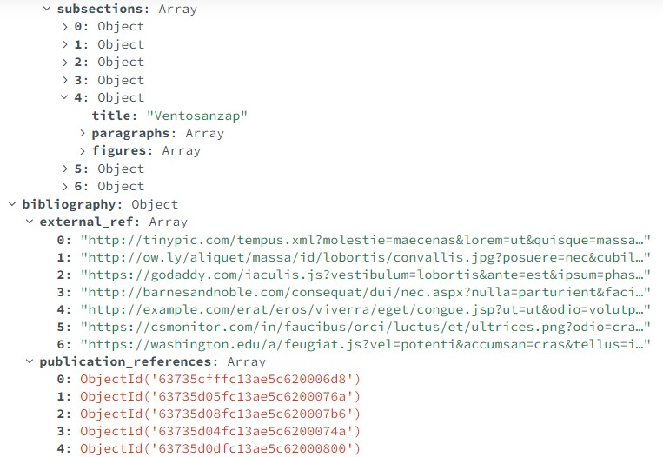
MongoDB
Subsections have the same structure of sections, but they don’t contain other subsections
The references to other publications are present in an Array of ObjectId, where each ObjectId is the id of a publication present in the database.

Slide 18
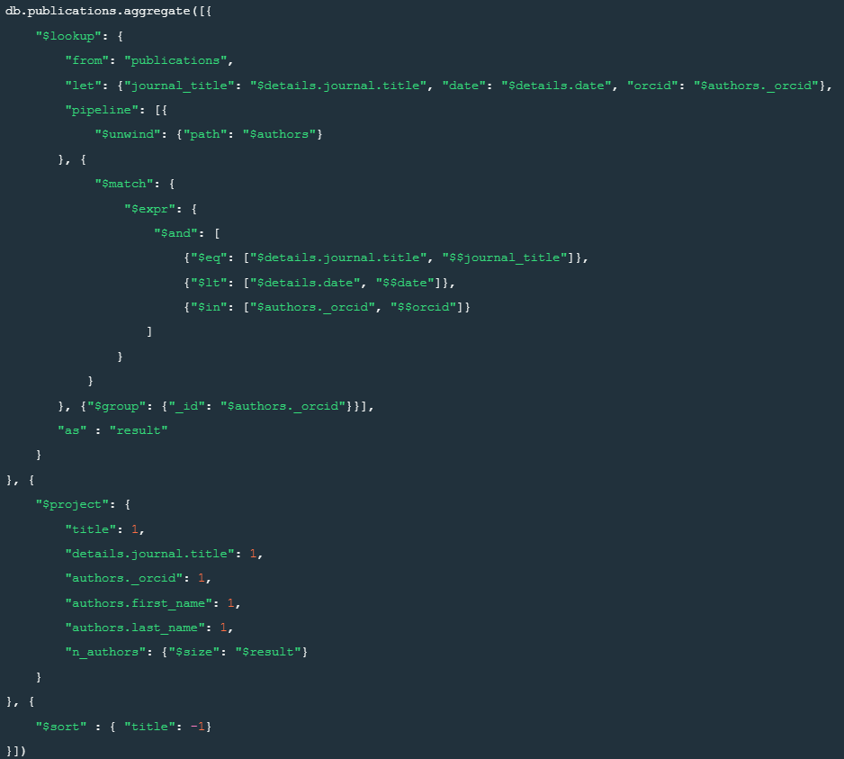
MongoDB
An example of query
For each publication, find the number of authors that have already contributed to some publications that were published in the same journal

Slide 19
MongoDB
An example of query
1. Unwind the authors of the joined publication
2. Join conditions:
same journal
an author in common
published in a previous date
3. Group by the orcid of the author
4. Calculate the number of authors
5. Sort wrt the title in descending order

Slide 20
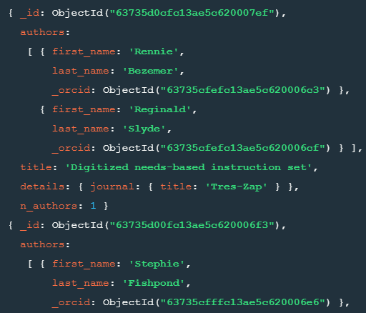
MongoDB
Results

Slide 21
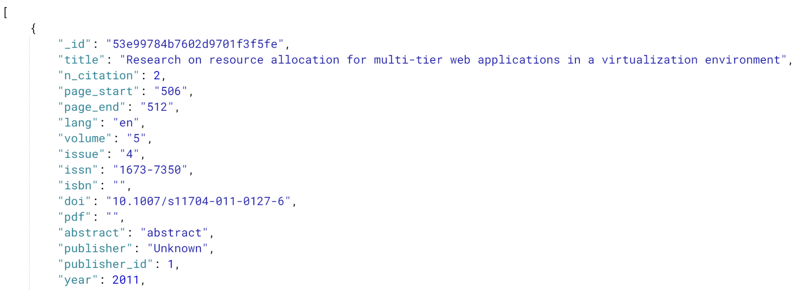
Spark
Data Structure example part 1
: use for the query explained after
Publication (array of objects)

Slide 22
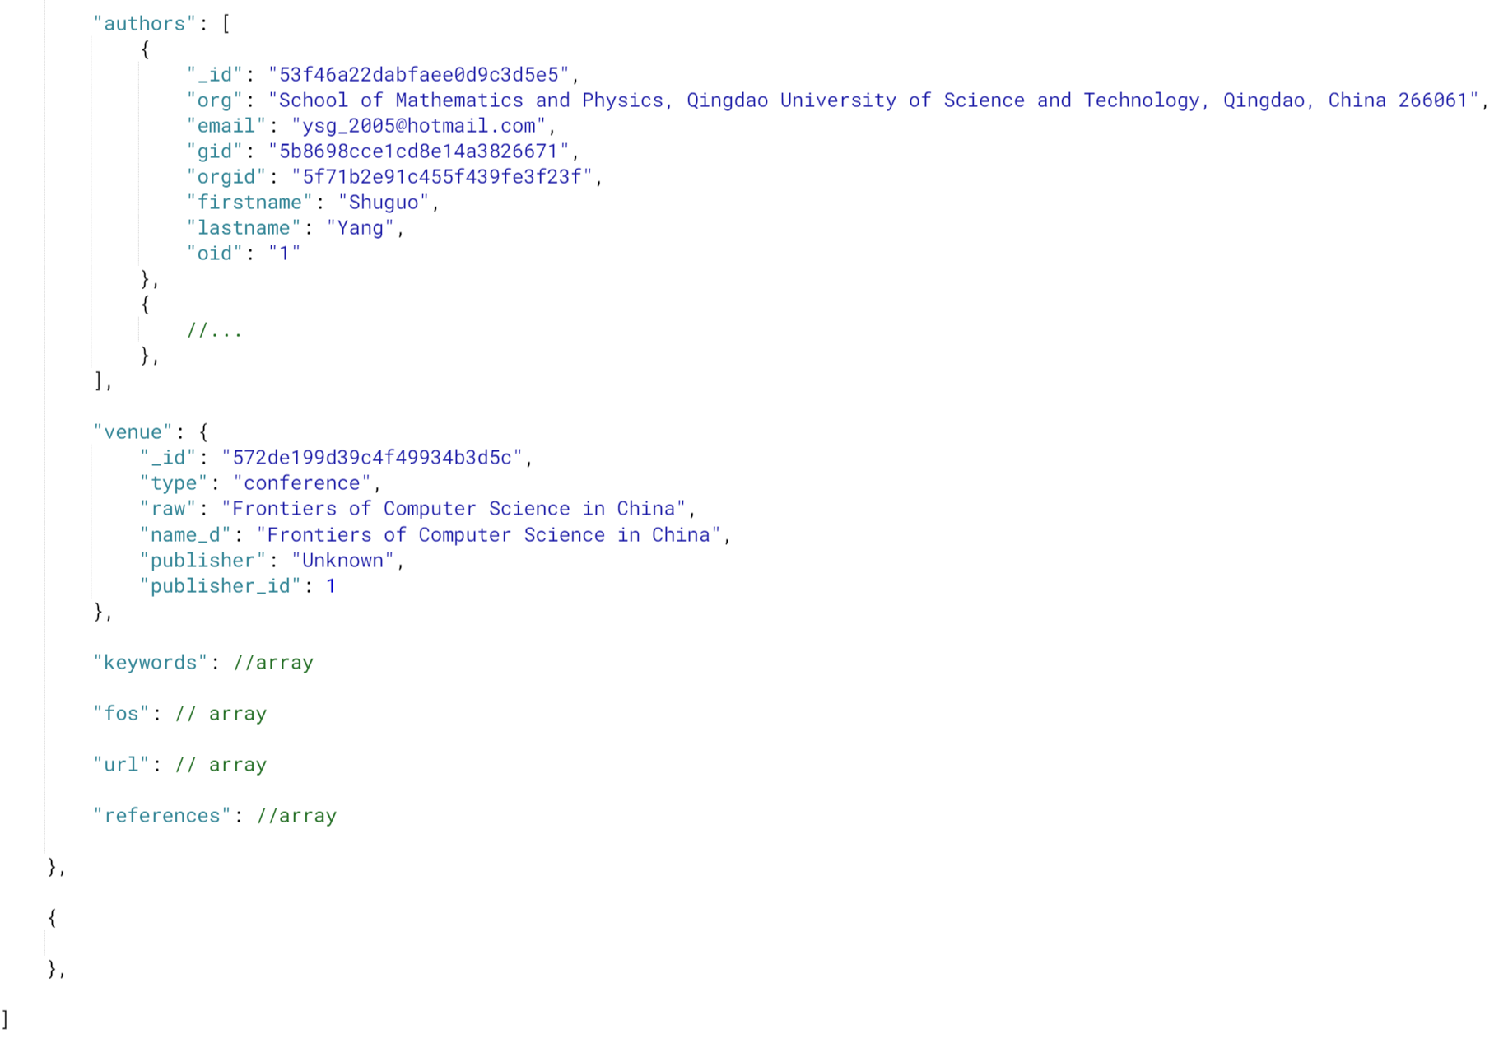
Spark
Data Structure example part 2
Array of objects
Object
Array of Strings
Publication
(array of objects)

Slide 23
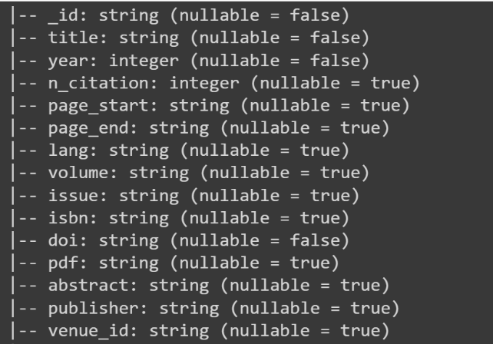
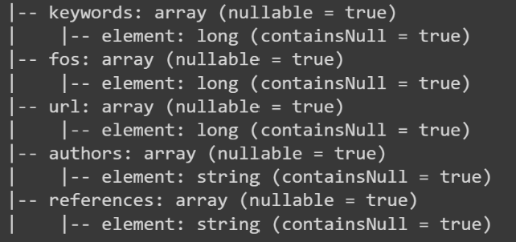
Spark
Data General Structure
data from .JSON file
1 spark.createDataFrame()
Total access
Publication
6 spark.createDataFrame()

Slide 24
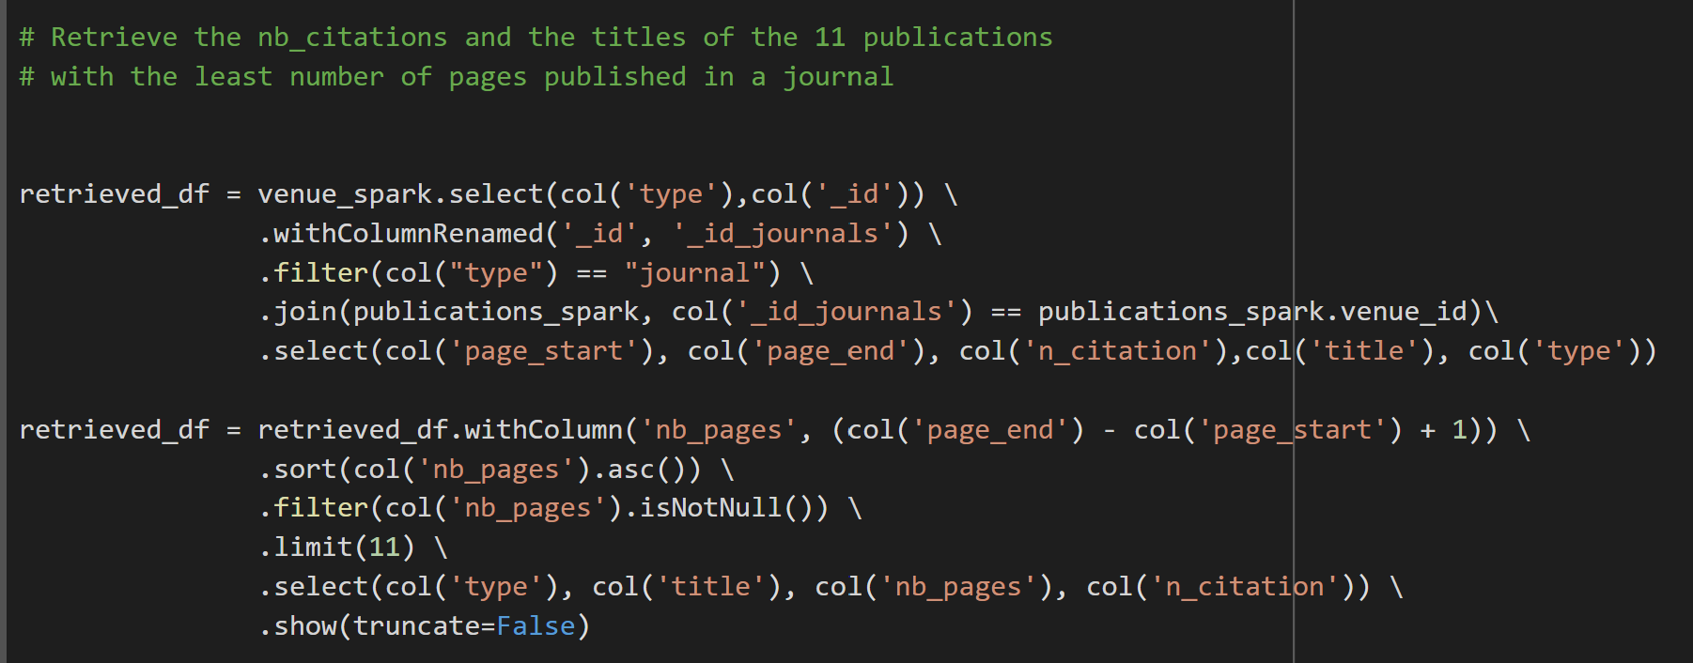
Spark
An example of query
1
2
Select data in Venue Data Frame in order to filter only the journals
Join a part of Venue and Publication Data Frames based on the journal’s ids
→ use attributes to do our query
Calculate and Sort (ascending) the number of pages, and Filter for ‘null’ values
Apply a Limit of the 11 first publications retrieved and their number of citations

Slide 25
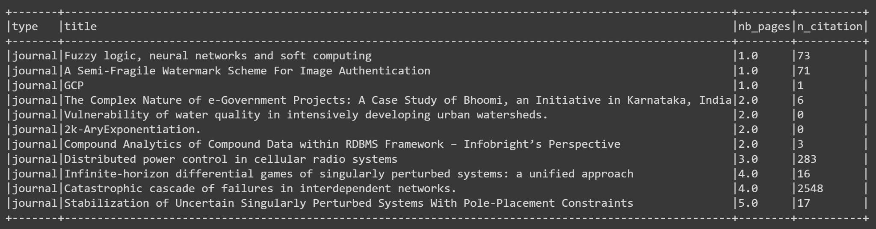
Spark
Results

